Slide 1
Batch File Command
With Computational Thinking Approach
Ben Tong
May 25, 2002.

Slide 2
採取CT的研究方法

Slide 3
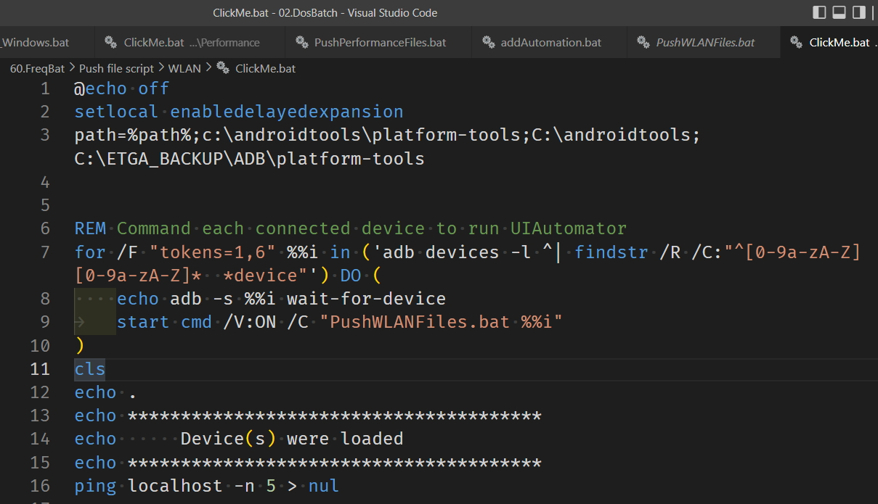

Slide 4
FOR 迴圈的概念 – 過去的經驗
計數 (0~有限次數)
重複做

Slide 5
Abstraction – 抽象
從一個集合裡面，遍歷每一個對象，然後去做一(些)事情。

Slide 6
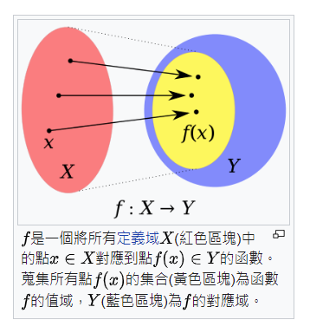
FOR %%x IN (集合) DO command f(x)

Slide 7
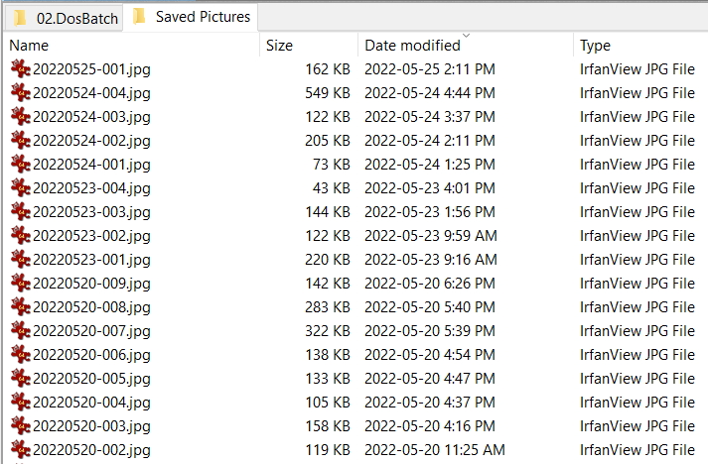
集合 – A set of Files
ForStruct.cmd

Slide 8
集合—A set of List (清單)
Mon Tue Wed Thu Fri Sat Sun
Jan Feb Mar Apr May Jun Jul Aug Sep Oct Nov Dec
1 2 3 4 5 6 7 8 9 10
%1 %2 %3 %4 %5 %6 %7 %8 %9
ForStruct.cmd

Slide 9
/R
/D
/L
/F
FOR %%x IN (集合) DO command f(x)

Slide 11
syntax-FOR-Files
FOR %%parameter IN (set) DO command
syntax-FOR-Files-Rooted at Path
FOR /R [[drive:]path] %%parameter IN (set) DO command
syntax-FOR-Folders
FOR /D %%parameter IN (folder_set) DO command
syntax-FOR-List of numbers
FOR /L %%parameter IN (start,step,end) DO command
syntax-FOR-File contents
FOR /F ["options"] %%parameter IN (filenameset) DO command
FOR /F ["options"] %%parameter IN ("Text string to process") DO command
syntax-FOR-Command Results
FOR /F ["options"] %%parameter IN ('command to process') DO command

Slide 14
Q&A
FOR %%var IN (set) DO 有幾種選擇(options)? 分別代表甚麼功能 或 作用?

Slide 15
FOR %%variable IN ( ) DO 有幾種選擇? 分別代表甚麼功能 或作用?

Slide 16
工程師方法論有哪三個重要的心法

Slide 17

自學參考
https://peterju.gitbooks.io/cmddoc/content/chapter1.html

